Slide 1
MICROSOFT AT THE MOVIES
By Alejandro Harrison

Slide 2

Business Overview
Microsoft has decided to try their luck at making movies
Looking at data from 2010-2018, 3 key factors were associated with high gross box office earnings and high reviews:
Genre of movie
Production budget of film
Partnering with another movie studio

Slide 3
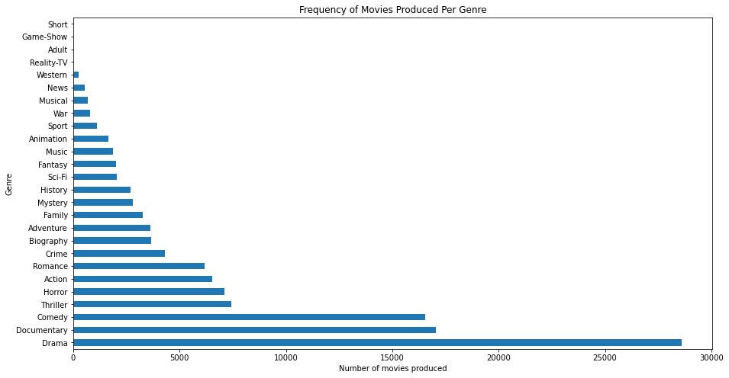
Most Produced Genre
IMDB dataset contains over 68,000 movie entries which include genre, average rating, number of votes, etc
Most produced type of movie was the Drama genre, which accounted for almost half of the total movies in the dataset
Notes:
Starting off by looking at the most produced type of genre in the dataset, I found that the most produced type of movie was in the Drama genre, which accounted for almost half of the total movies in the dataset.

Slide 4
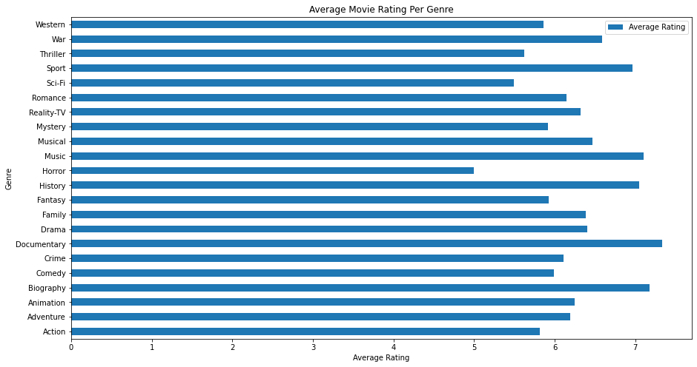
Movie Rating and Genre
Next, I wanted to look at average movie rating for each genre
Taking into account frequencies of each genre, I graphed the average movie rating per genre

Slide 5

Movie Rating and Genre
Documentary genre has the highest average movie ratings for a genre, closely followed by the sport, musical, and history genres
Each of these genres incorporate elements of drama into them
Notes:
The highest average movie ratings for a genre belongs to the documentary genre, but is closely followed by the sport, musical, history and biography genres.
If we balance both movie rating and number of movies per genre produced then based on the sheer amount of movies in the drama genre produced, using genres that can incorporate aspects of drama would be wise.
using genres that can incorporate aspects of drama would be wise therefore the best genres to focus on would be sport, history or musical.

Slide 6

Production Budget
Production budget can include:
Crew and cast salaries
Post production editing
Filming and equipment costs
Travel costs
Marketing
Notes:
The second factor that I’ve identified as an indicator of success is production budget of a movie.

Slide 7
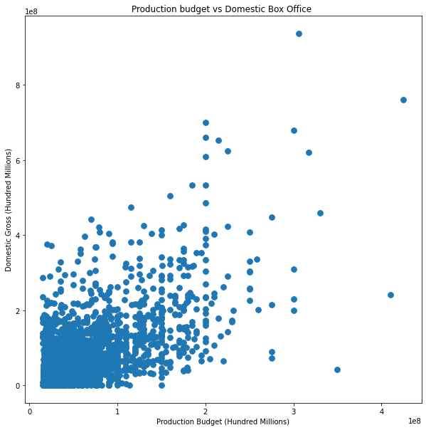
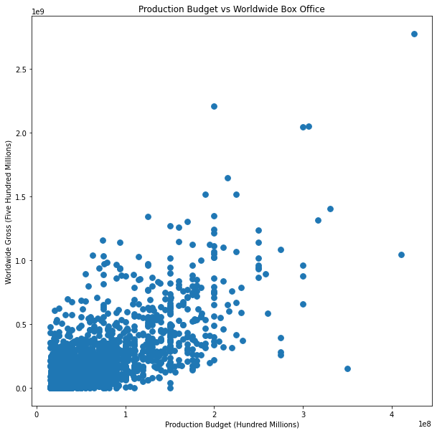
Production Budget Correlation
The Numbers dataset contains over 8000 movies and includes their production budget as well as domestic and global box office earnings
Worldwide box office and production budget had a Pearson’s correlation coefficient of 0.748, while Domestic had a PCC of 0.686
Higher production cost is correlated with higher box office earnings
Notes:
I wanted to see if there was a relation between production cost and gross box office earnings.
I took a dataset (from The Numbers) containing over 8000 movies, that also contained their production budget as well as domestic and global box office earnings.
I then ran a Pearson's correlation test on production budget and both box office earnings.

Slide 8
Average Production Budget
Average production budget is $31,587,757 with a standard deviation of $41,812,076
The best production budget to maximize profits is between 100 million and 200 million dollars

Slide 9

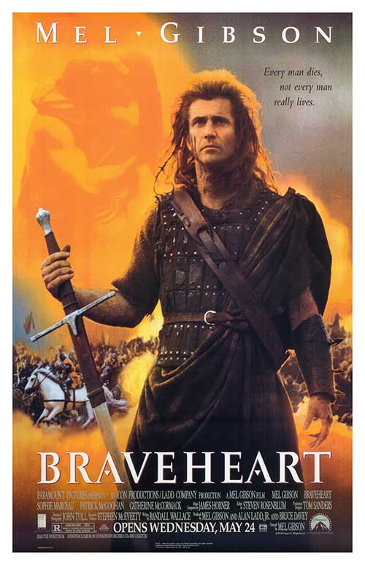

Partnering With Another Movie Studio
Having a partner gives the ability to work with a successful, experienced company and provide access to resources such as seasoned directors, writers, and post production crew
Some examples of movies where studios worked together include Titanic (Paramount and 20th Century Fox), Spaceship Troopers (Sony Pictures, Tristone Pictures and Touchstone Pictures) and Braveheart (Paramount and 20th Century Fox).
Notes:
This brings me to my last factor: Partnering up with another movie studio.

Slide 10
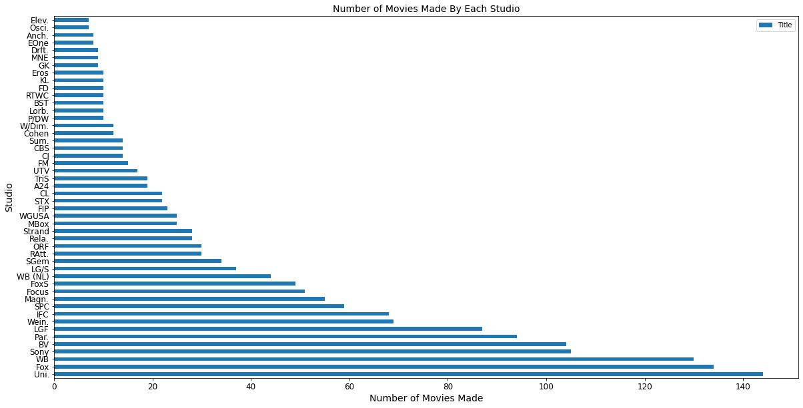
Movie Studios And Movie Frequency
Halving total amount of studios (172), then halving it again, narrows results down to top 43 studios
Top producers of movies: Universal, Fox, and Warner Brothers
Notes:
Box Office Mojo dataset contained over 2000 movies.
Each entry had the domestic/foreign box office earnings as well as the studio that made the movie.

Slide 11
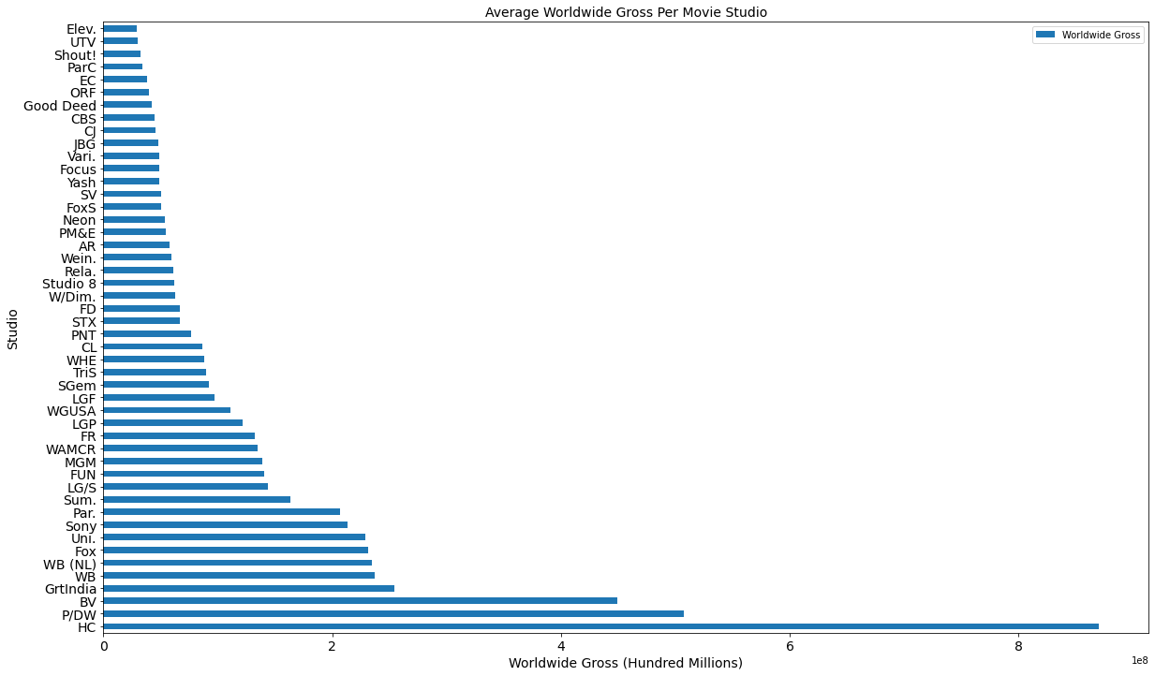
Movie Studios And Worldwide Gross
Top highest average worldwide grossing movie studios include: P/DW, Disney, and Warner Brothers
Notes:
I then looked at which movie studios had the highest average worldwide grossing movies

Slide 12

Movie Studio Choice
Warner Brothers Studios
Top 3 for most movies produced
Top 5 for top average worldwide grossing movies
Been around for over 90 years
Produced some of the most popular movies out there like the Harry Potter series, The Matrix series, The Lord of The Rings series, etc.
Wide selection of movie genres produce from action to drama to comedy to musicals

Slide 13
Recommendations
Best genres to focus on include documentary, sport, history, and musical
Ideal budget to maximize profits is between 100 and 200 million dollars
Movie is successful if gross box office earnings are twice the production budget
Partner up with Warner Bros
Highly experienced with many high grossing box office hits
Notes:
Based on the massive amount of movies in the drama genre produced, using high rating genres that can incorporate aspects of drama would be wise.

Slide 14
Questions and Contact Info
Questions?
Any additional inquires can be directed to linkedin:
https://www.linkedin.com/in/alejandro-harrison-948034108/

